Slide 1
Django Class Room App

Slide 2

Table of Contents
01
Strategy
02
Picking the Right Strategy
Authentication and Authorization
Practical Example
03
04

Slide 3
STRATEGY
How you are going to implement multiple user types depends on the requirements of your application. Below, a few questions you have to ask yourself: -How much information specific to each type of user you need to maintain? - Can the users have more than one role in the application? E.g. can a User be a Student and Teacher at the same time? -How many different types of users the application will need to manage?

Slide 4
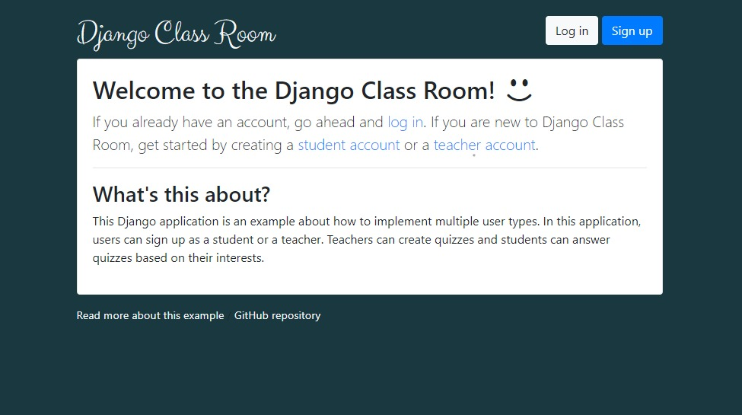

Slide 5
PICKING THE RIGHT STRATEGY
I created the flowchart below to help you decide what’s the right strategy for you.
The orange diamonds are decision points; questions that you need to answer so to define the most suitable option.
The blue rectangles are actions you will need to perform based on your decisions.

Slide 6
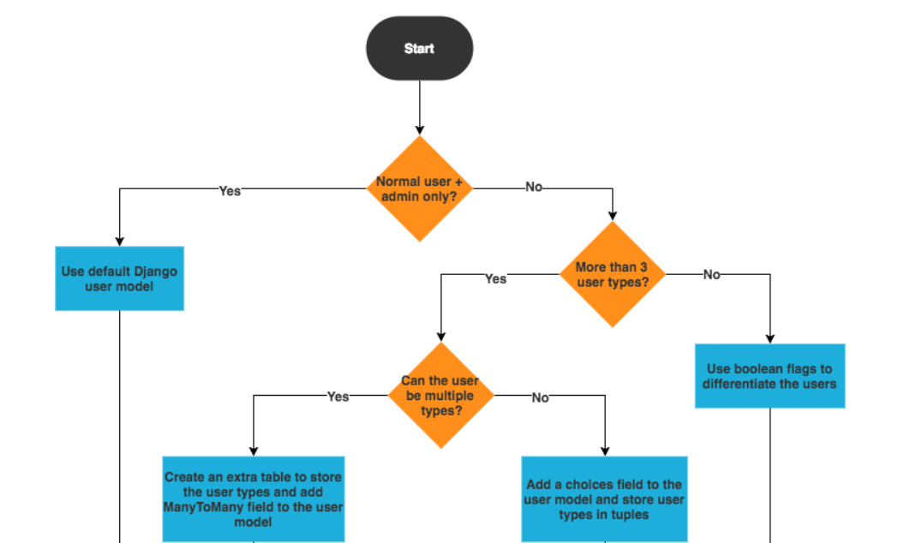

Slide 7
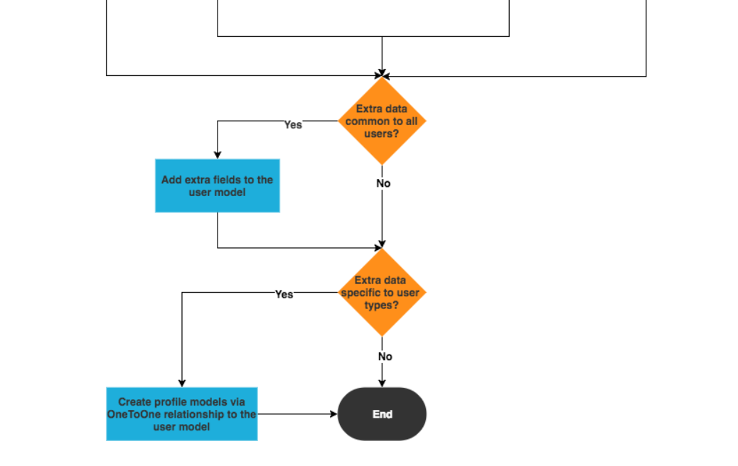

Slide 8
Authentication and Authorization
Before we jump into the implementation, it is important to highlight those two concepts: Authentication (Login) Authorization (Permission) Authentication is the process of verifying if the person is who they claims to be. In practical terms, it’s the process of verifying username and password (login). Authorization is the process of verifying what this particular person is allowed to do in the application. This can be achieved using view decorators, Django’s built-in permissions framework, or some third-party app like django-guardian or django-rules.

Slide 9
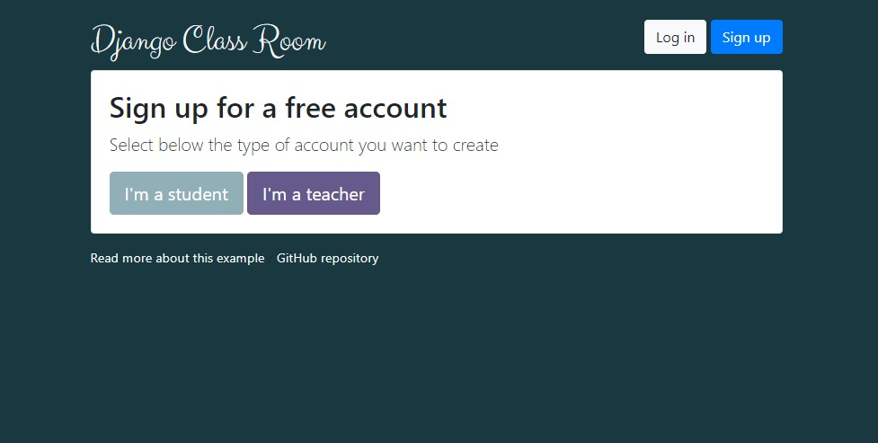
PRACTICAL EXAMPLE
Asks the user if they want to sign up as a student or as a teacher:

Slide 10
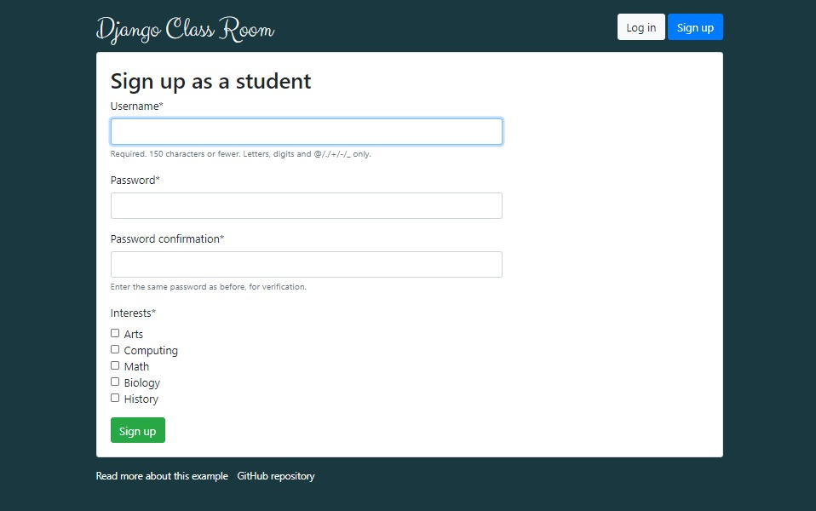
Sign up as a student:

Slide 11
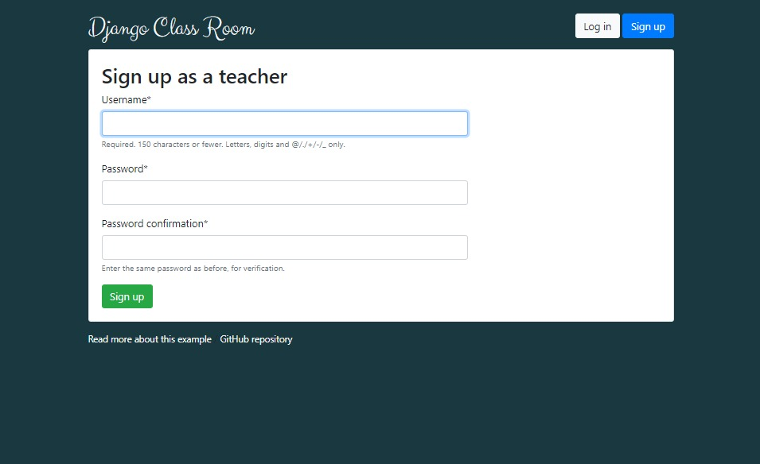
Sign up as a teacher:

Slide 12
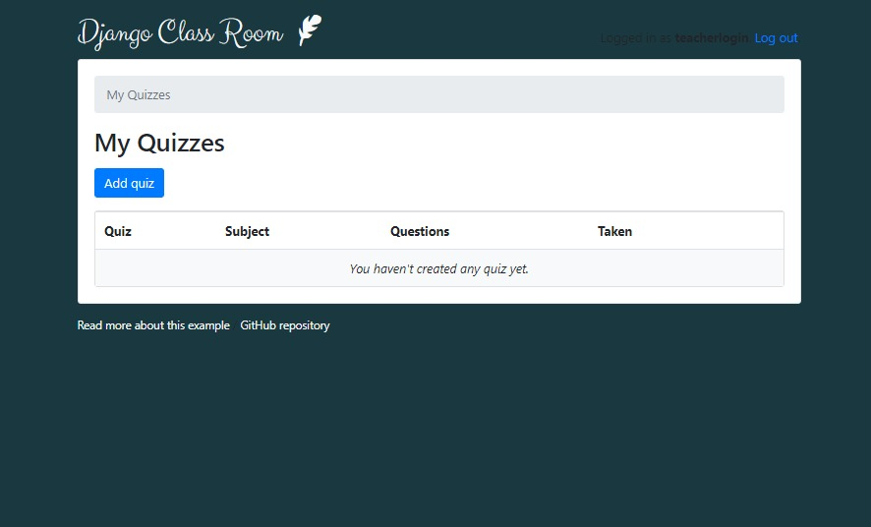
Teachers create quiz and view results of the taken quizzes:

Slide 13
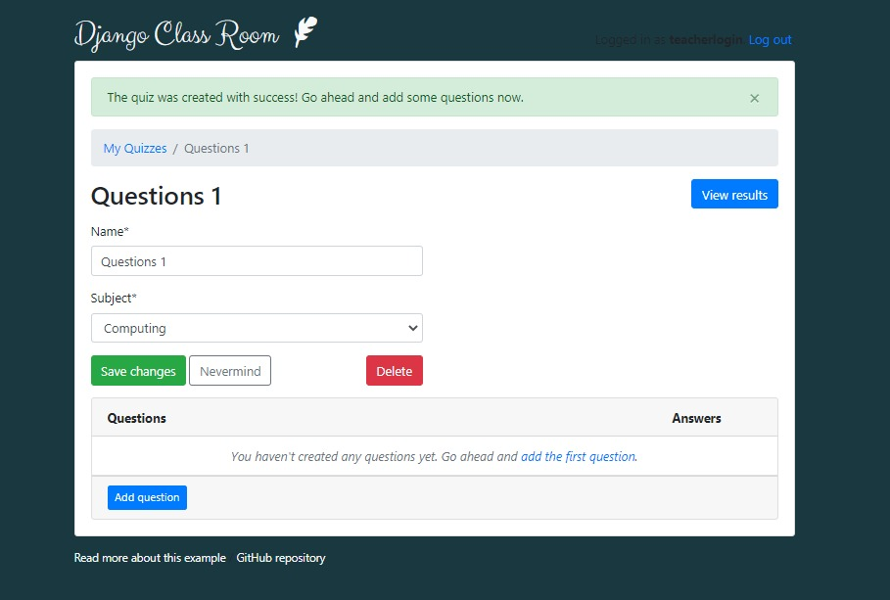

Slide 14
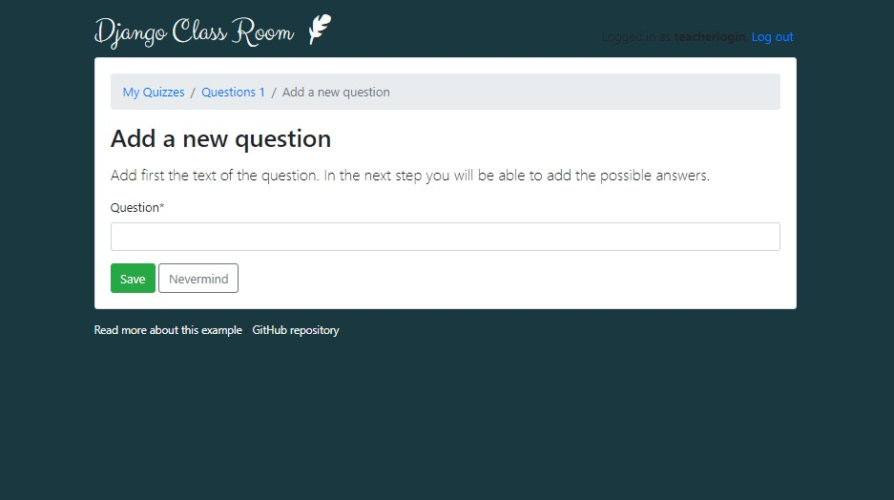

Slide 15
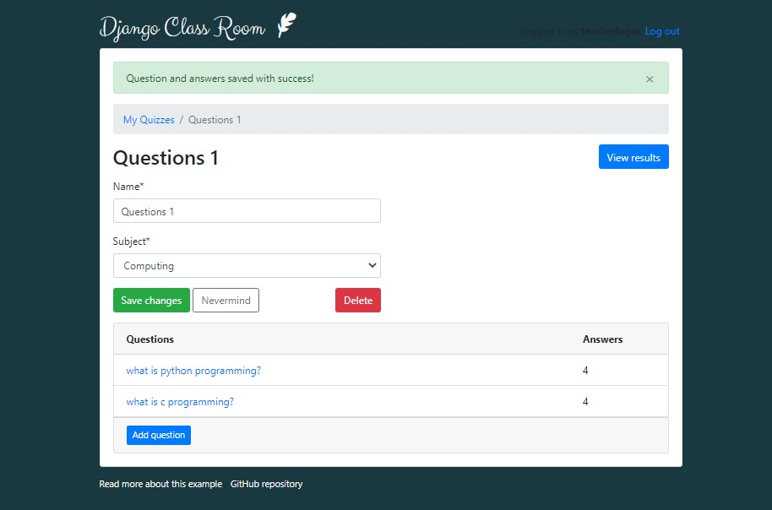

Slide 16
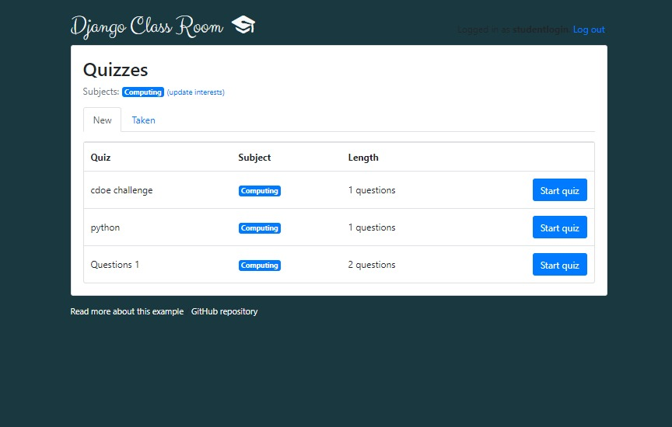
Saturn is the ringed one and a gas giant

